Slide 1
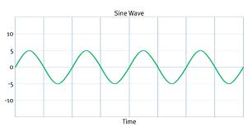
Period & Frequency
f = 1/T
Period of a wave (T)
The time it takes a wave to complete one cycle.
T is measured in seconds
Frequency of a wave (f)
The number of cycles that can be completed in 1 second
f is measured in Hz (Hertz)
1 Cycle
λ

Slide 2
Wave Equation
v = λf
Speed (v) of a wave is a property that ties together frequency and wavelength.
Speed of a wave depends on the property of the medium.
e.g. speed of light in air is greater than speed of light in crown glass (Grade 10 Optics)
Therefore the wavelength changes to compensate and the light ray bends (Grade 10 Refraction)

Slide 3
Examples
The frequency of Middle C on a piano is 262 Hz. What is the period of the sound wave?
Use: f = 1/T or T = 1/f
Answer: 0.00382 s
3.82x10⁻³ s
If the speed of sound is 344 m/s, what is the wavelength of Middle C?
Use: ν = λf or λ = ν/f
Answer: 1.31 m

